Slide 1







Monthly Meeting
Agenda

Slide 2


January
2026

Slide 3






Agenda Preview
Reading and Approval of Minutes
Reports of Officers
Unfinished Business
New Business
Announcements
Adjourn

Slide 4





Reading and Approval
of Minutes
We need someone to approve the minutes as read
OR
If the minutes are incorrect please raise your hand and make corrections

Slide 5
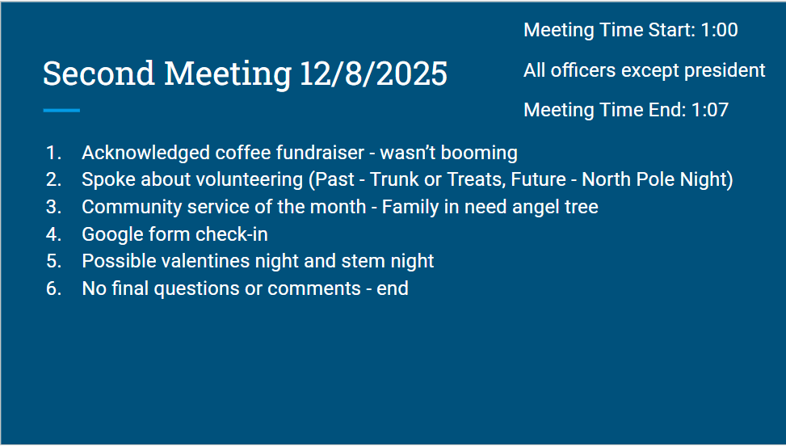

Slide 6


Presidents Report

Slide 7



Vice President’s Report
Interested in becoming a national officer?
You can apply today for leadership!
Applications are due February 24, 2026
If selected for the next phase, you’ll be notified March 21,2026
*You MUST attend the 2026 national conference for training in Oregon*
https://members.pdkintl.orgNational_Student_Officers_zs=JQiXg&_zl=Rkjm4&_redirected=1

Slide 8

Treasurer’s Report
Cash Box: $30.00
Cash to deposit $742.00
Bank Account $-138.13

Slide 9

Unfinished Business
We held our North Pole Night and made $350
Thank you to everyone who participated in the Stanwood Family Angel Tree
January Fundraiser: Spectrum Fudge
Orders Due Feb 3
Orders will be given to you Feb 12 or 13
All orders are placed online- the customer can pay to have them shipped or if they are local they can choose to have them delivered by you
January Service Project

Slide 10

New Business
Future Fundraisers:
Community Service
February
March- Beverly’s Birthdays
April
May
Scholarship Opportunities
Zoom- Jan 22 to learn more
Applications on Ed Rising Portal
Competition Descriptions

Slide 11
Competition General Information
Acceptable Attire
Pants: Dress slacks, khakis, dressy jeans (no holes), capris
Skirts/Dresses: Knee-length or longer; comfortable for sitting
Tops: Dress shirts, blouses, sweaters, polos (Educators Rising polos encouraged)
Shoes: Flats, loafers, boots, conservative sneakers, dress shoes, heels
No AI Usage

Slide 12
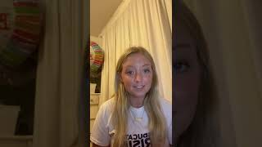
Creative Lecture

Slide 13
Creative Lecture

Slide 14

Public Service Announcement (PSA)

Slide 15
Public Service Announcement (PSA)

Slide 16
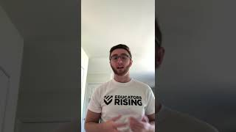
Public Speaking

Slide 17
Public Speaking

Slide 18
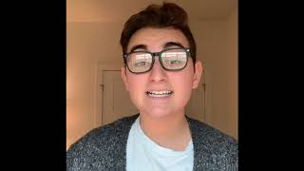
Educators Rising Moment

Slide 19
Educators Rising Moment

Slide 20

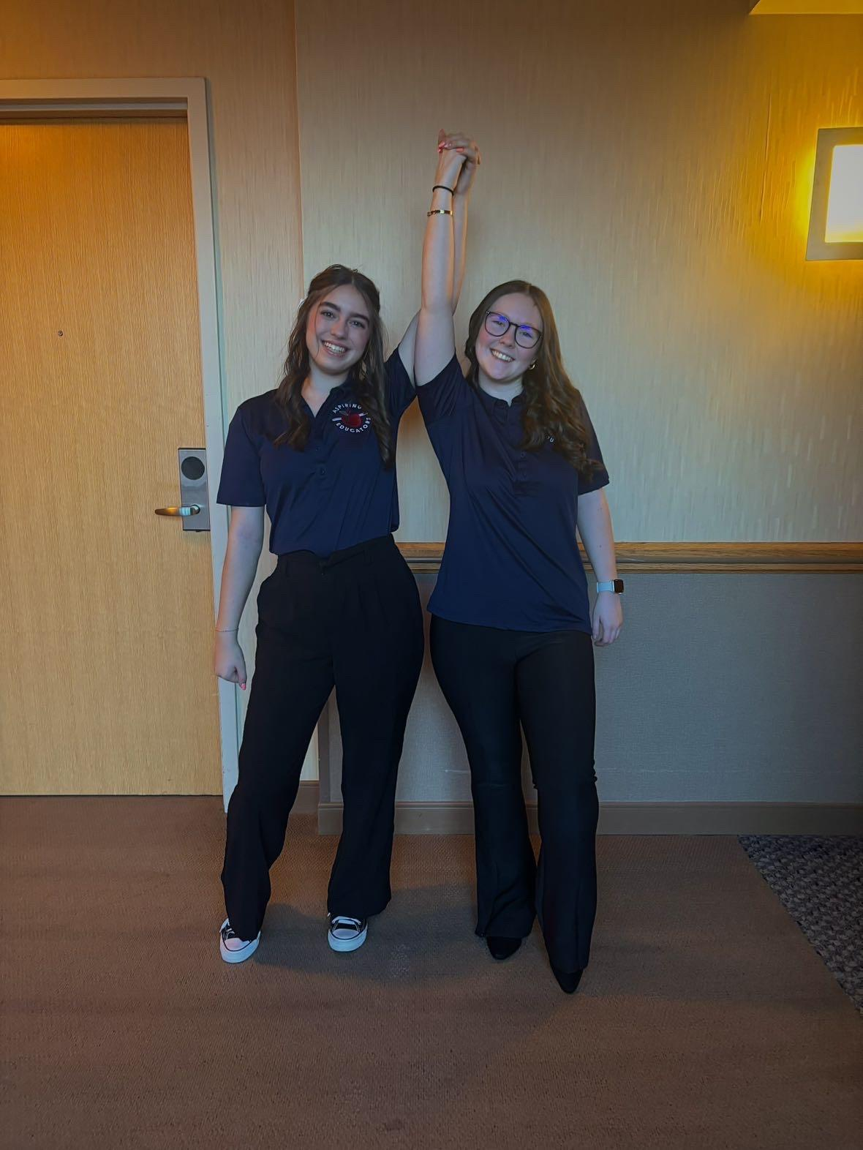
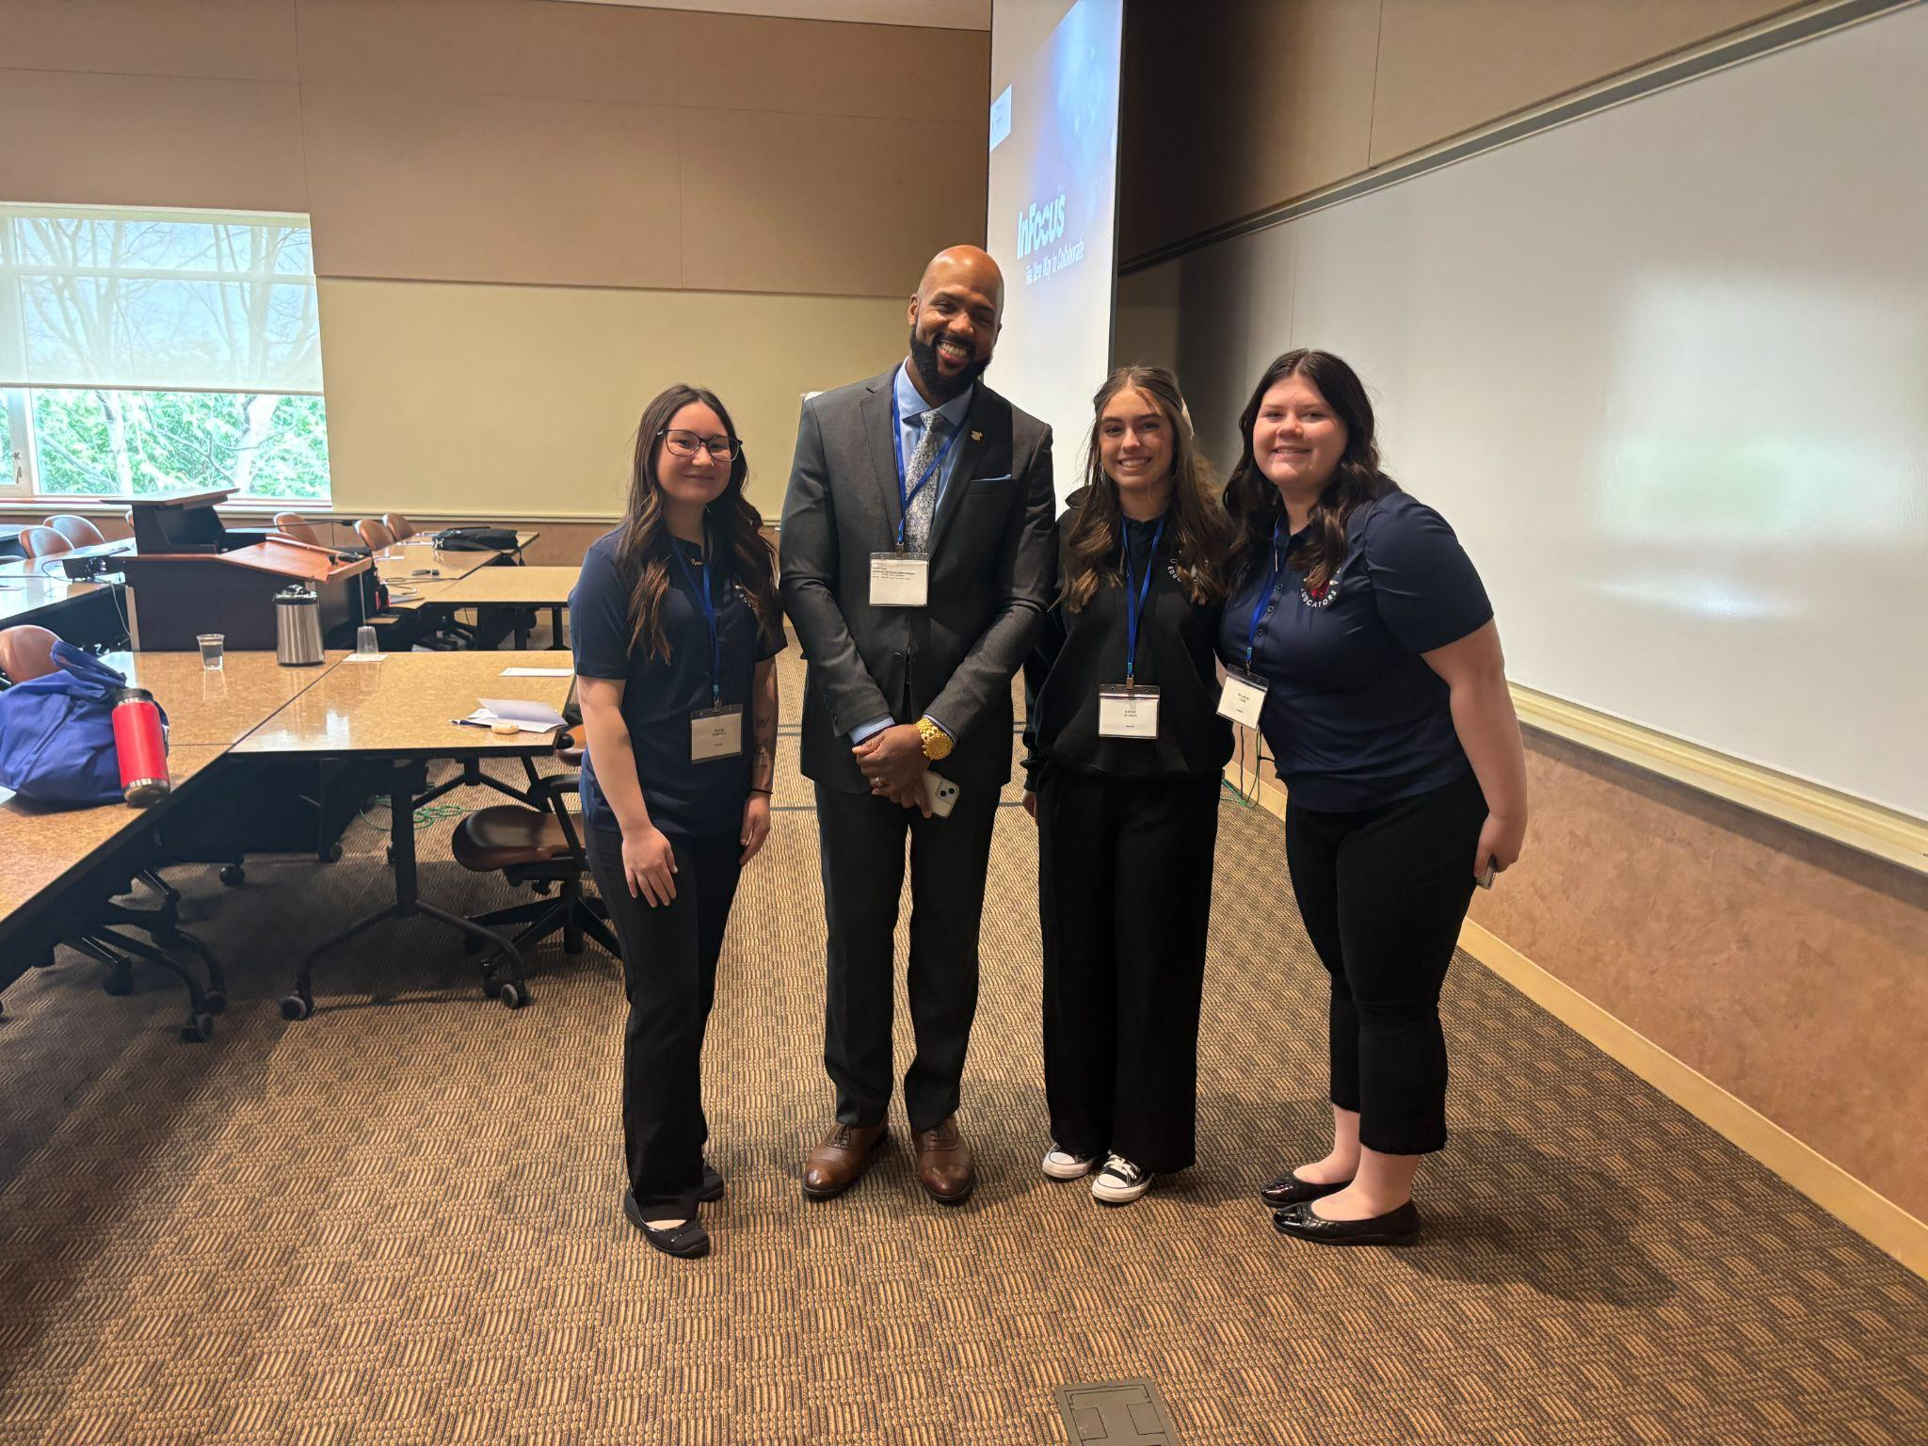
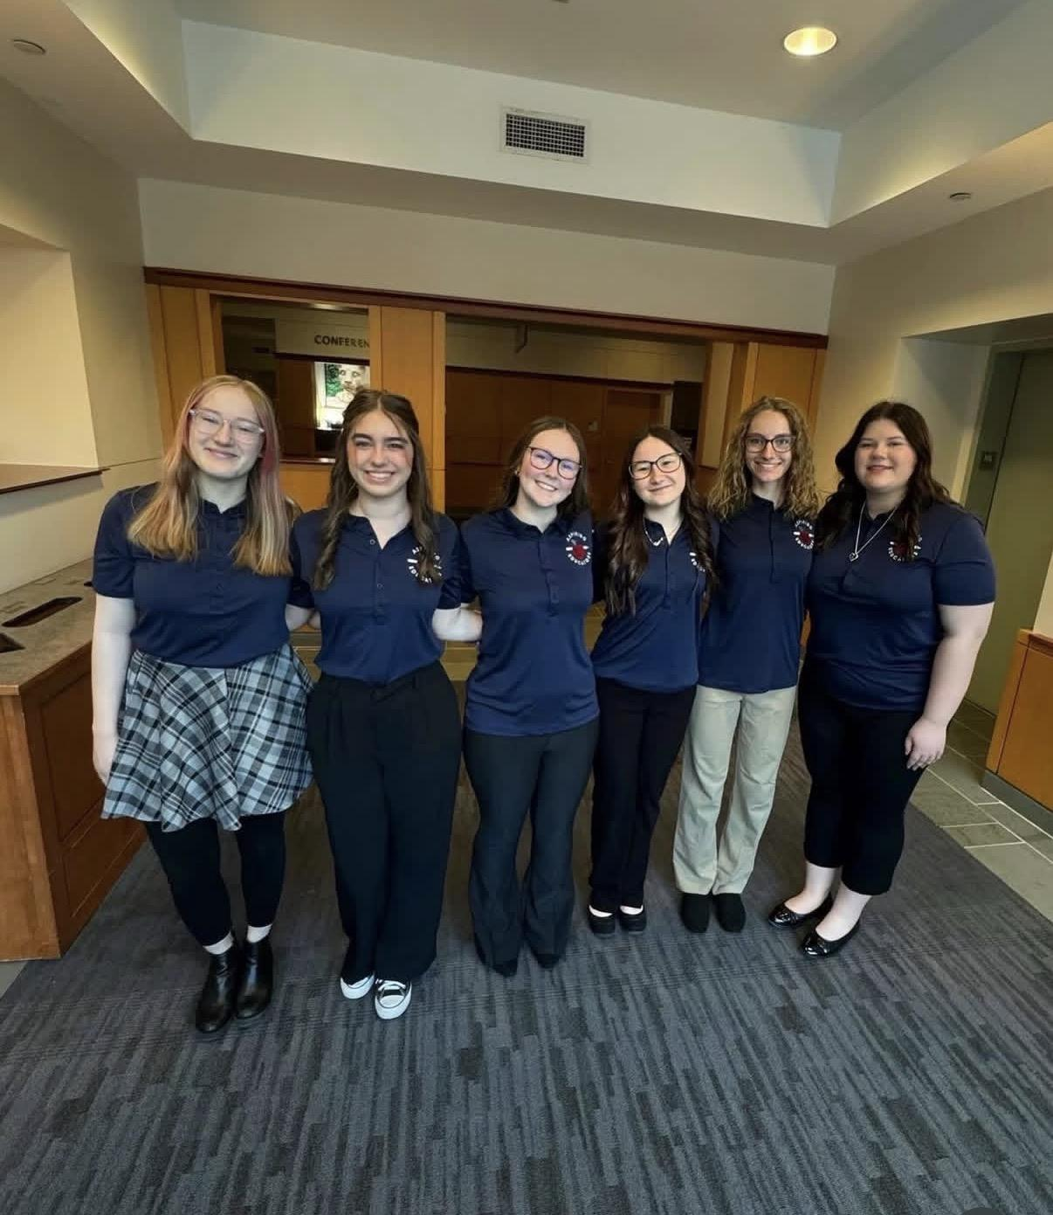
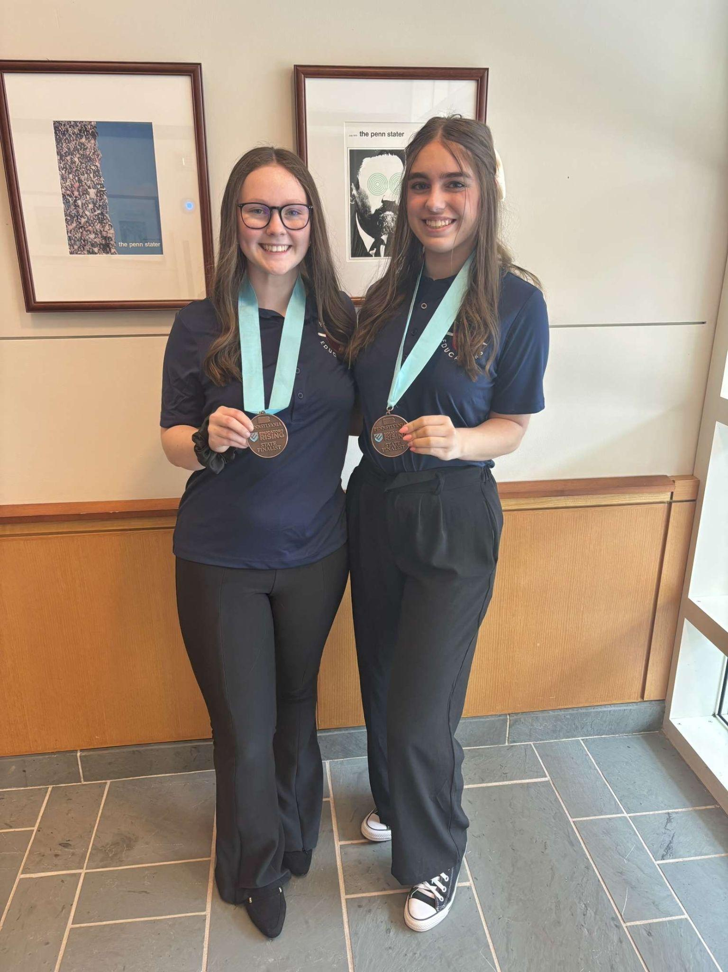
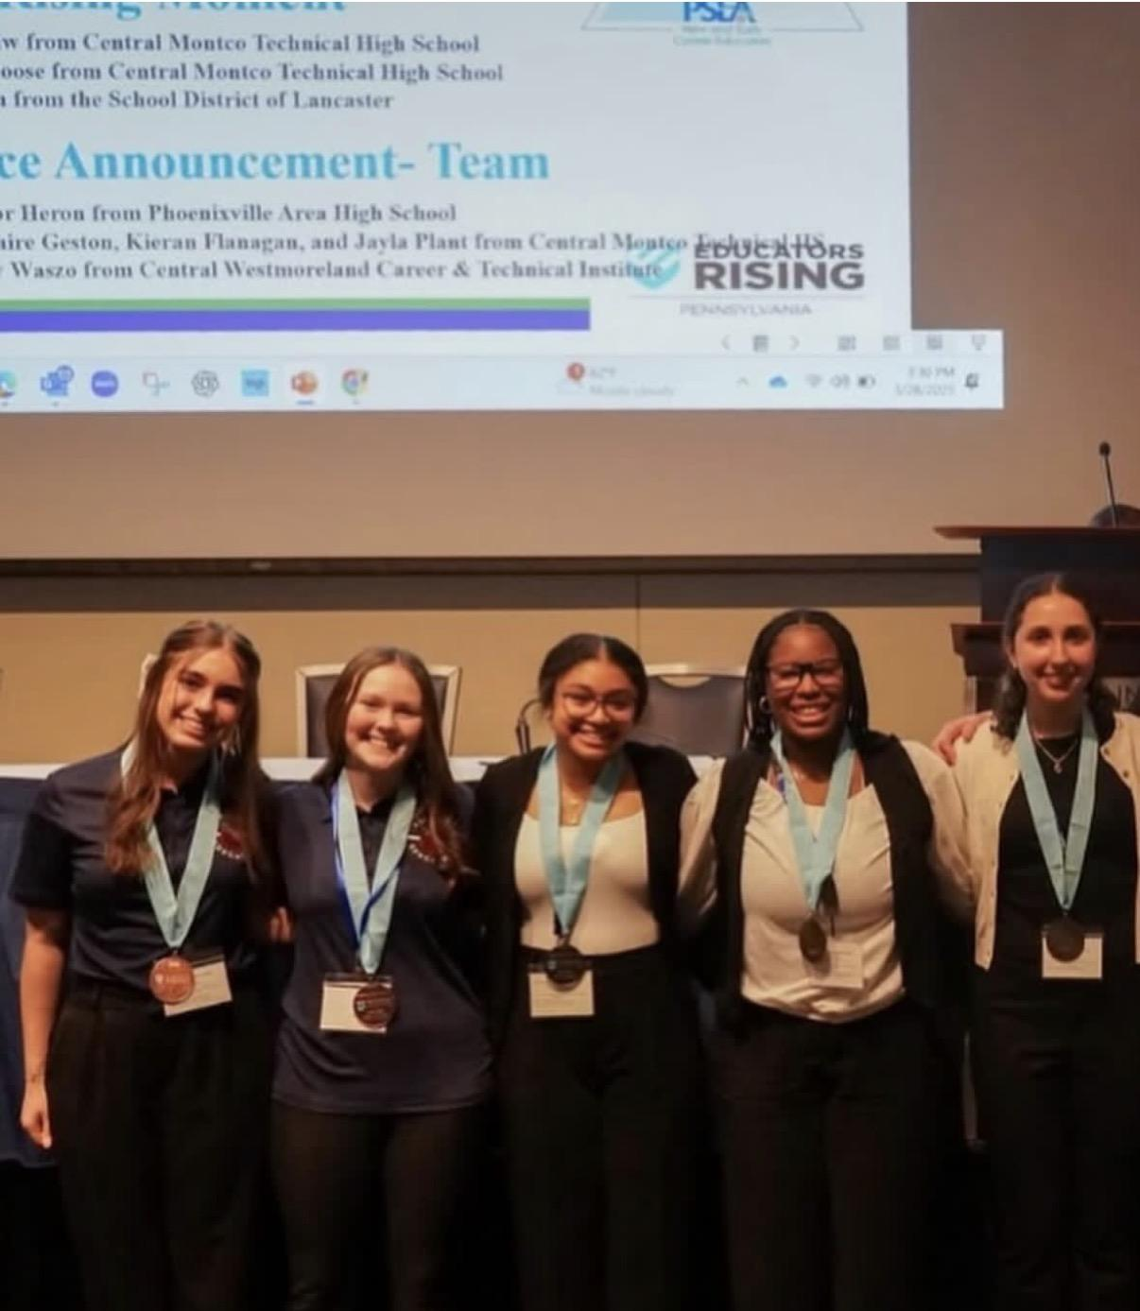
Pictures from Ed. Rising

Slide 21

Next Meeting
Tuesday February 3

