Slide 1







Monthly Meeting
Agenda

Slide 2


February
2026

Slide 3






Agenda Preview
Reading and Approval of Minutes
Reports of Officers
Unfinished Business
New Business
Announcements
Adjourn

Slide 4





Reading and Approval
of Minutes
We need someone to approve the minutes as read
OR
If the minutes are incorrect please raise your hand and make corrections

Slide 5
Meeting Time Start: 12:50
All officers present
Meeting Time End: 1:50
Meeting 1/13/2026
Reading and approval of minutes - Approved
Reports of officers:
  President -
  Vice President -
  Treasurer - $603.87
Unfinished Business -
New Business:
  Service Projects - only March so far (Beverly’s Birthdays)
  Scholarship Opportunities
  Competition Descriptions for Ed Rising - and general information
Announcements -
No final questions or comments - end

Slide 6


Presidents Report

Slide 7



Vice President’s Report
Happy Educators Rising Week! Feb 2-6

Slide 8

Treasurer’s Report
$2133.26 in our account

Slide 9

Unfinished Business
Spectrum Fudge Orders are due TODAY
Future Fundraisers:
Community Service
February
March- Beverly’s Birthdays
April
May
Scholarship Opportunities
Zoom- Jan 22 to learn more
Applications on Ed Rising Portal

Slide 10

New Business
Competitions:
Caitlin Haney- Ed Rising Moment
Harley Wilson & Addy Martinelli- PSA
Abby Rayman & Torrie Rhoades- PSA
Leah Boris & Vivian Gale- PSA
Next week- Bracelet Sales for Stanwood Students

Slide 11
Competition General Information
Acceptable Attire
Pants: Dress slacks, khakis, dressy jeans (no holes), capris
Skirts/Dresses: Knee-length or longer; comfortable for sitting
Tops: Dress shirts, blouses, sweaters, polos (Educators Rising polos encouraged)
Shoes: Flats, loafers, boots, conservative sneakers, dress shoes, heels
No AI Usage

Slide 12
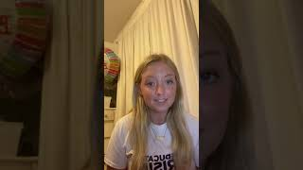
Creative Lecture

Slide 13
Creative Lecture

Slide 14

Public Service Announcement (PSA)

Slide 15
Public Service Announcement (PSA)

Slide 16
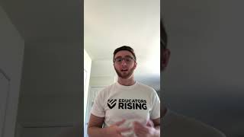
Public Speaking

Slide 17
Public Speaking

Slide 18
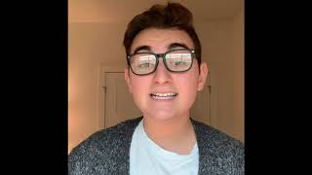
Educators Rising Moment

Slide 19
Educators Rising Moment

Slide 20
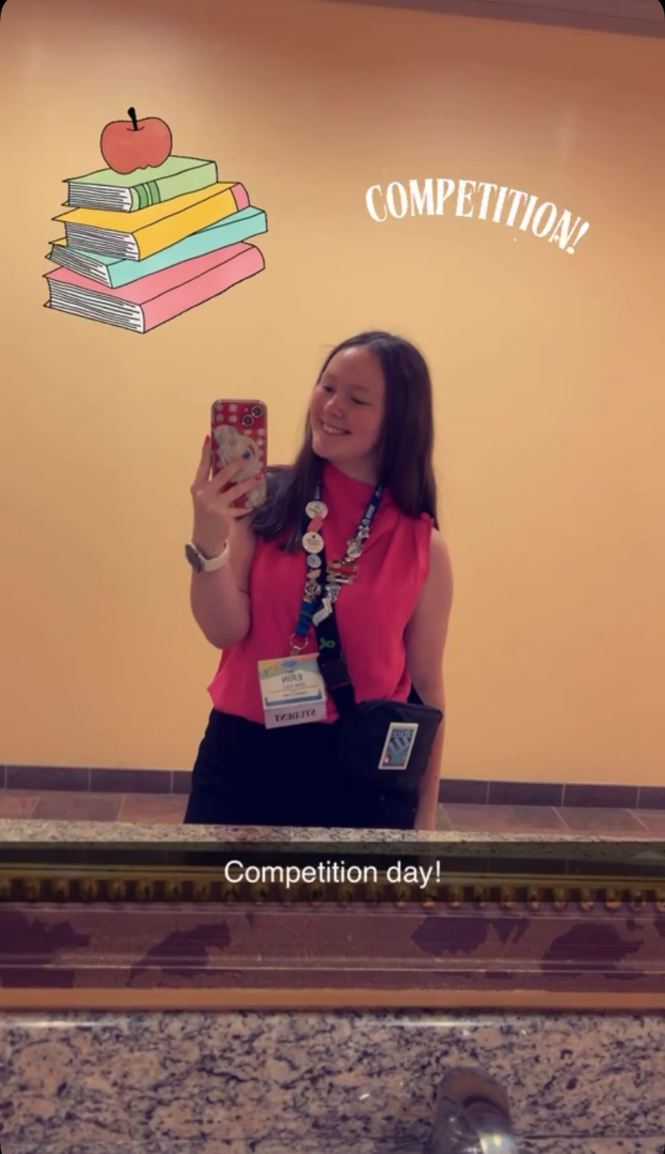
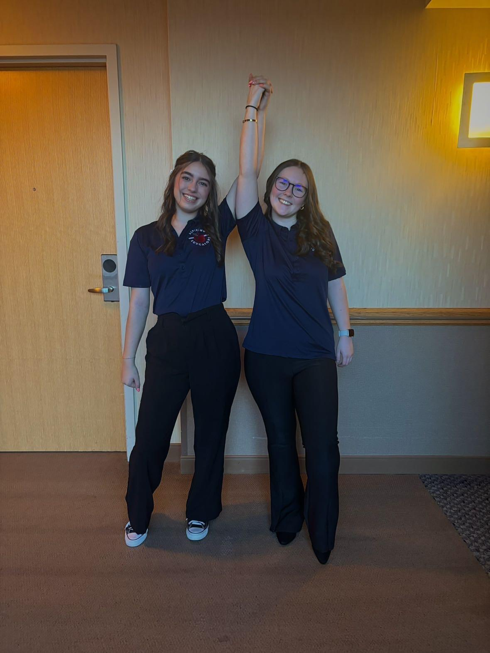
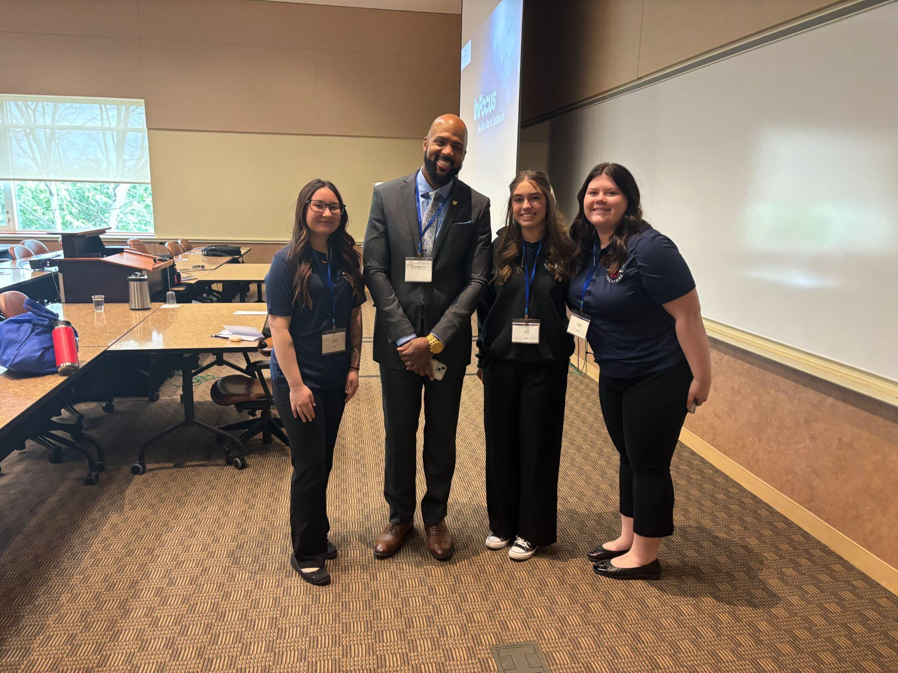
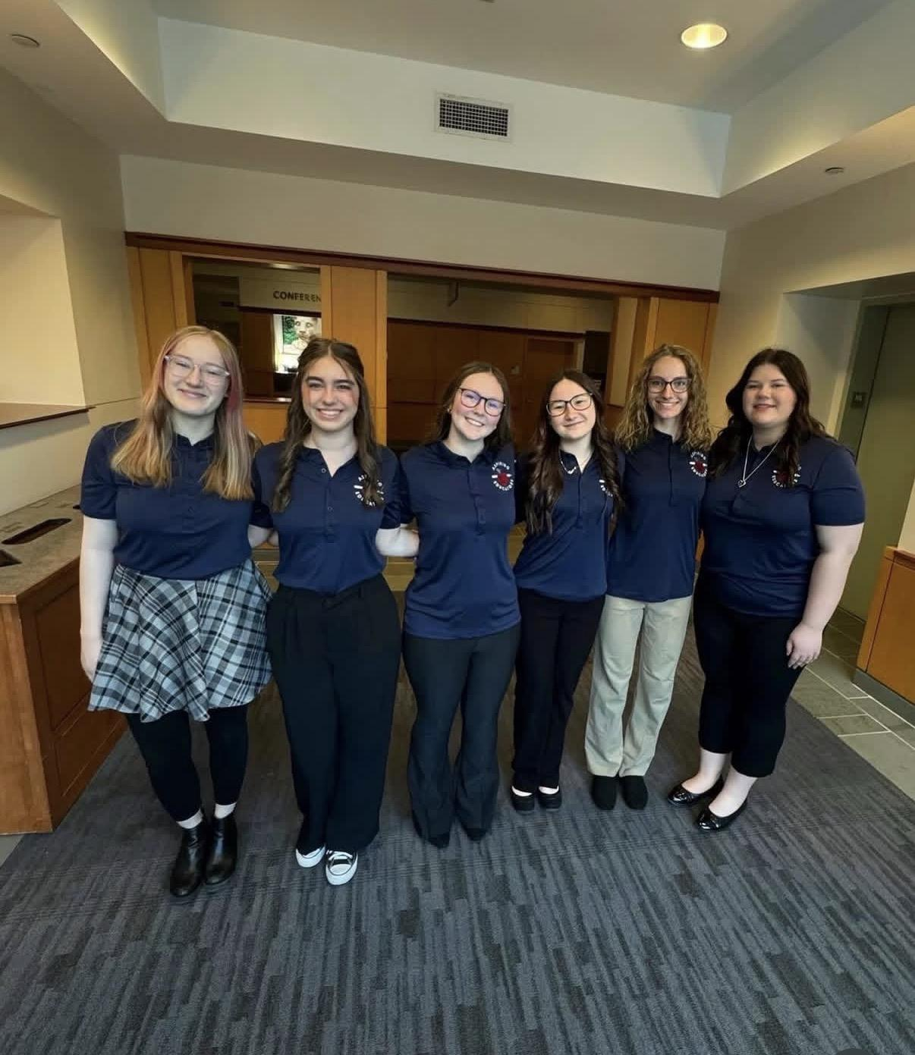
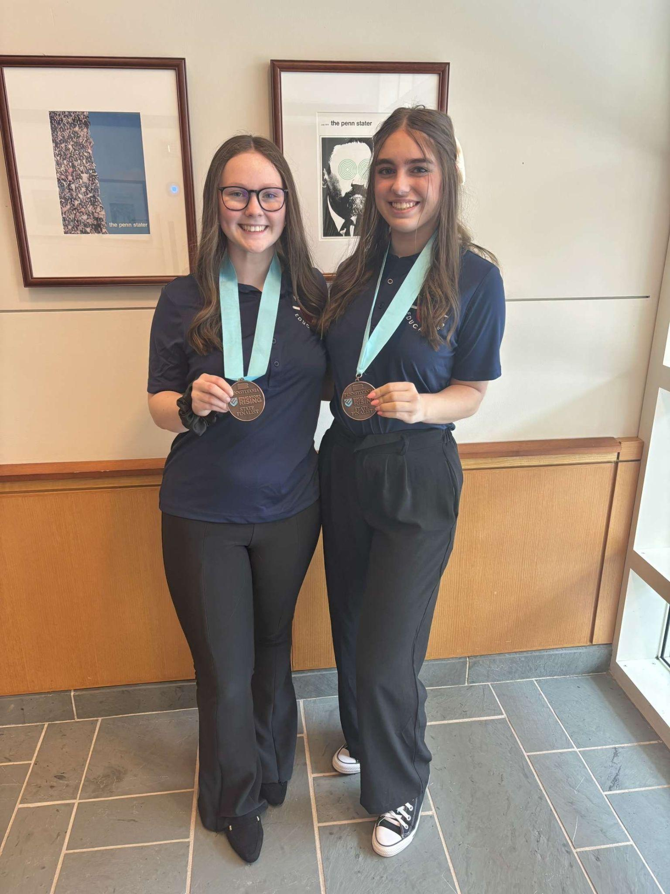
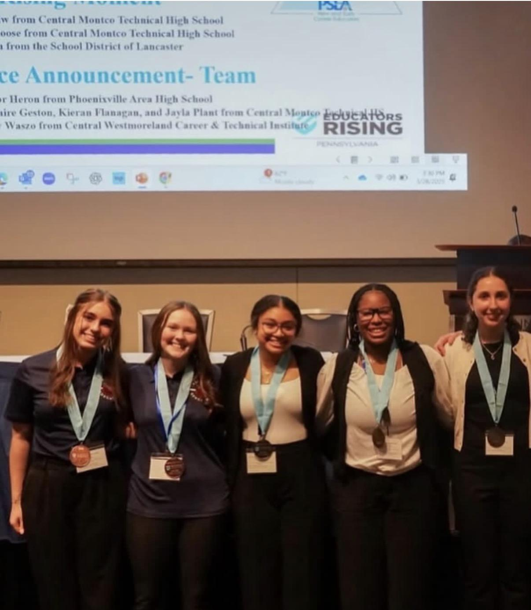
Pictures from Ed. Rising

Slide 21

Next Meeting
Tuesday February 3

